Slide 1
Enews Express
Business Statistics
19th August 2022

Slide 2
Contents / Agenda
Executive Summary
Business Problem Overview and Solution Approach
EDA Results
Hypotheses Tested and Results
Appendix

Slide 3
Executive Summary
E-news Express, an online news portal wants to expand its business by acquiring new subscribers and their design team has researched and created a new landing page which has a new outline and more relevant content shown compared to the old page. An experiment was further conducted on two randomly selected groups to monitor the interaction of these users with the new landing page and old existing landing page. I have been provided with data and after thorough exploration and statistical analysis of the data, the following are my deductions:
From the sample data which contains 100 observations made by the control group (old page users) and treatment group (new page users) we observed that the users spent more time on the new landing page than the old landing page.
We observed that from our 100 users that 54 users converted to subscribers and 46 did not.
The users that converted to subscribers (yes) spent an average of about 6.2 minutes on the page while the users who didn't convert spent an average of around 4 minutes.

Slide 4
Executive Summary
The conversion rate for users on the new landing page is greater than conversion rate of users to subscribers the old landing page.
The conversion status from users to subscribers was not dependent on any preferred language.
From our visual analysis it seems that users who preferred English language spent a longer time than users who preferred French and Spanish languages, however after carrying out the analysis of variance test, I had to conclude that the same average time was spent by all users regardless of language preferred, bearing in mind that the difference in time spent was not more than a minute difference.

Slide 5
Executive Summary
Conclusions and Recommendations
It is glaring that the A/B technique experiment conducted by the Data Science team was quite successful. They have been able to test the effectiveness of the new landing page by seeing how their online users have responded to it, this is evidenced by the longer period spent on the new landing page and the rate at which users subscribed when compared to the old existing page.
As this experiment has proved to be successful on a sample size, E-news Express can take bolder steps in designing a more improved and engaging landing page to drive better engagement amongst users such that more users will convert to subscribers and boost the business further.

Slide 6
Business Problem Overview and Solution Approach
Objectives
Enews Express wants to expand its business by acquiring new subscribers and to achieve this they have successfully carried out an experiment on their users’ interaction on both their old landing page and their new landing page. As a data analyst, my responsibility is to explore the dataset, analyse it and address the following questions below:
Whether users spend more time on the new landing page than on the old landing page?
Comparing if conversion rate for the new page is greater than that for the old page?
To ascertain the relationship between converted status and the preferred language?
Analyse if time spent on the new page is same for the different language users?
After exploring, analysing the dataset and providing answers to the concerns raised by Enews Express. The company plans to act on my actionable insights and conclusion to further understand their user interests and determine how to drive a better engagement and expand their business successfully.

Slide 7
Business Problem Overview and Solution Approach
Methodology
To explore the dataset and extract insights using Exploratory Data Analysis, we carried out the following steps:
Imported the necessary libraries into our Google Colab
Uploaded the E-news Express dataset.
Carried out sanity checks on our dataset to ensure data was loaded properly.
Confirmed the absence of missing values.
Confirmed the absence of duplicated values.
Carried out Exploratory Data Analysis.
Carried out hypothesis testing.
Made inferences based on our hypothesis result.

Slide 8
EDA Results
Display data head to view the first few rows to ascertain if data has been loaded properly or not.
The dataset has 100 rows and 6 columns (4 categorical and 2 numerical variables).
There are no missing values evidenced by presence of only non-null counts.
There are no duplicates.
The dataset set comprises 1 float, 1 integer and 4 object data types.
Memory usage is at 4.8+ KB.
Statistical summary of numerical variables shows that mean time spent on the webpage is about 5.4 minutes, maximum time spent at 10.71 minutes while least time spent was 0.2 minutes.
Value counts of the categorical variable show:
Landing page is divided equally into old (50%) and new(50%) landing pages.
The user group is divided equally into Control (50%) and Treatment (50%)
Language preferred shows the following: Spanish-34 users, French-34 users and 32 users.
Users who converted to subscribers are 54 (Yes) and 46(No).

Slide 9
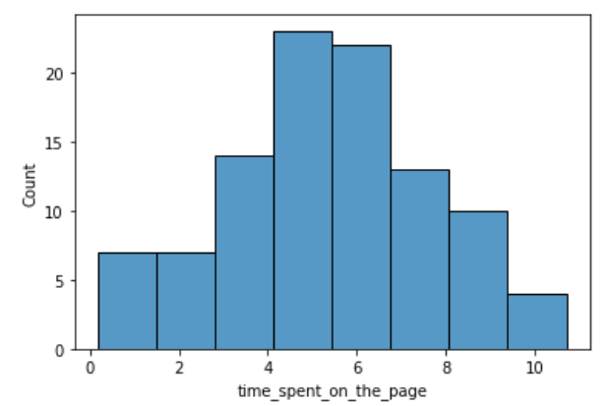
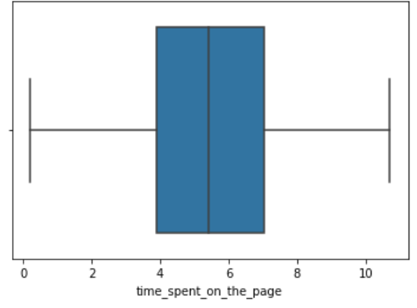
EDA Results
Univariate Analysis - Time spent on the page
This is a normal distribution with no evidence of outliers,
The longest time spent on the page is around 10.7 minutes while shortest time spent is around 0.2 minutes.

Slide 10
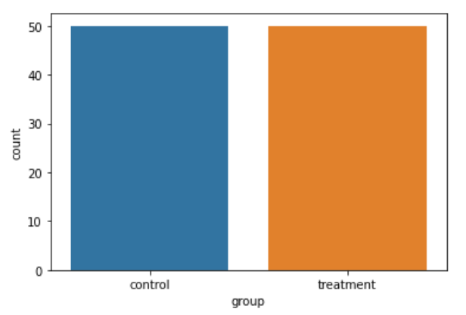
EDA Results
Univariate Analysis- Group
The user group is divided into
Control
Treatment
Link to Appendix slid on data background check

Slide 11
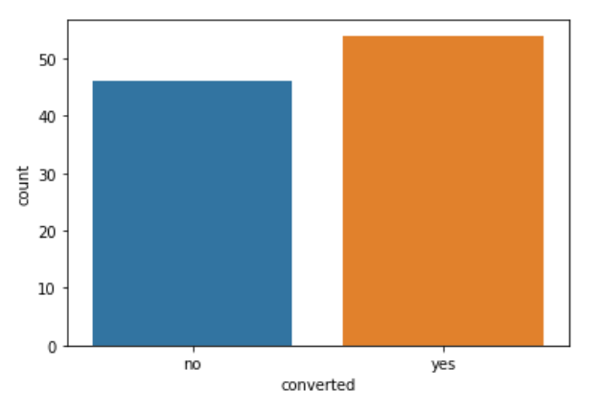
EDA Results
Univariate Analysis- Conversion status
The users who converted to subscribers:
No (did not convert)
Yes (converted)

Slide 12
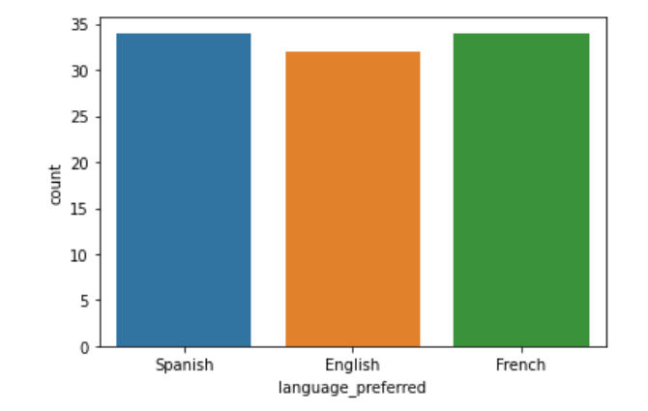
EDA Results
Univariate Analysis- Language preferred by users
The distribution shows that French and Spanish are the more preferred languages.

Slide 13
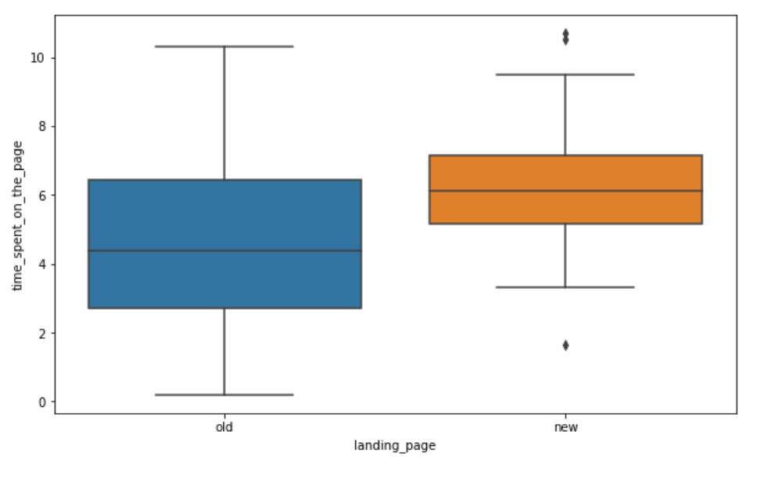
EDA Results
Bivariate Analysis- Time spent on the page vs. Landing page
The plot shows that the new landing page has some outliers on both sides.
The average time spent on the new landing page is about 6 minutes while average time spent on old landing page is around 4.5 minutes.

Slide 14
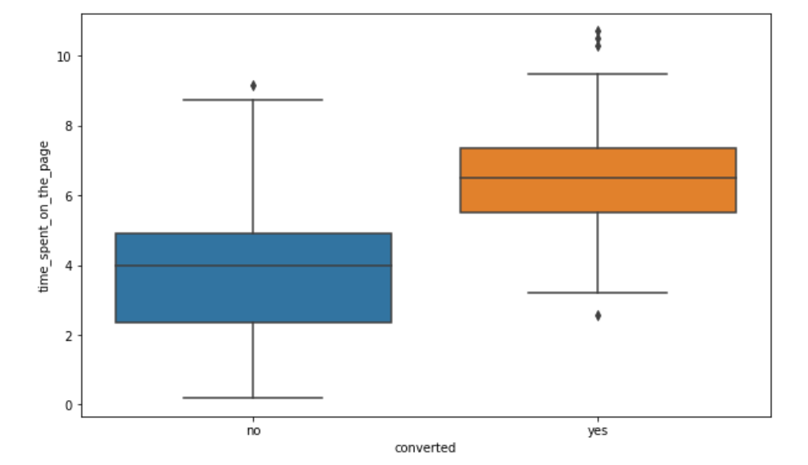
EDA Results
Bivariate Analysis- Conversion status vs. Time spent on page
The users that converted to subscribers (yes) spent an average of about 6.2 minutes on the page while the users who didn't convert spent an average of around 4 minutes.
The distribution shows that converted new subscribers spent a longer time than old subscribers.

Slide 15
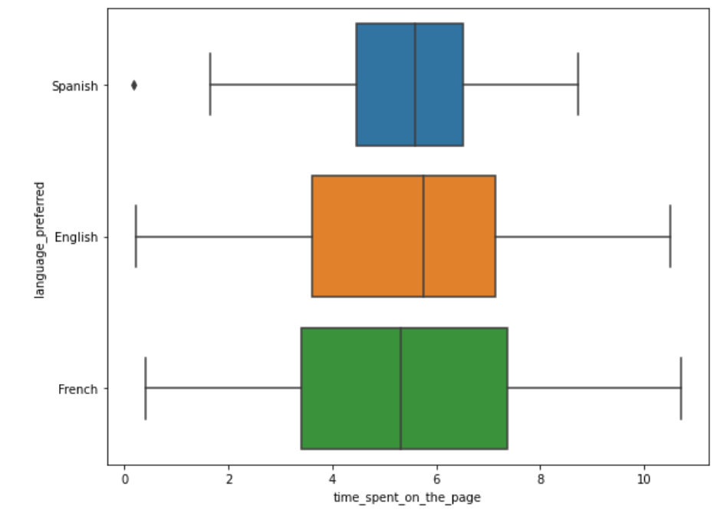
EDA Results
Bivariate Analysis- Preferred Language vs. Time spent on page
From our distribution it seems that the users who prefer English language spent longer average time than both users who prefer French and Spanish languages.
Users who prefer Spanish data has some outliers.

Slide 16
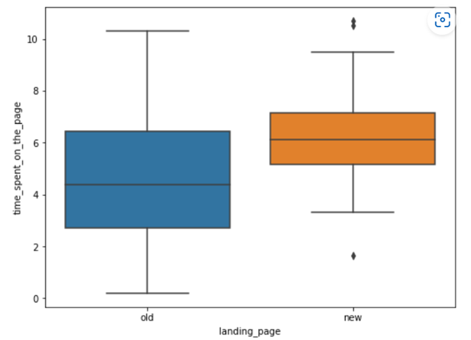
Hypotheses Tested and Results
Do the users spend more time on the new landing page than the existing landing page?
Time spent on the page vs. Landing page
Hypothesis Tested: Test to compare two sample means from two independent populations when standard deviation is unknown- 2 Sample Independent t-test.
The p-value is 0.0001392381225166549 and is less than the level of significance (α),
Inference
Therefore, I have enough statistical evidence to reject the null hypothesis and support the claim that users spend more time on the new landing page than the old existing landing page.

Slide 17
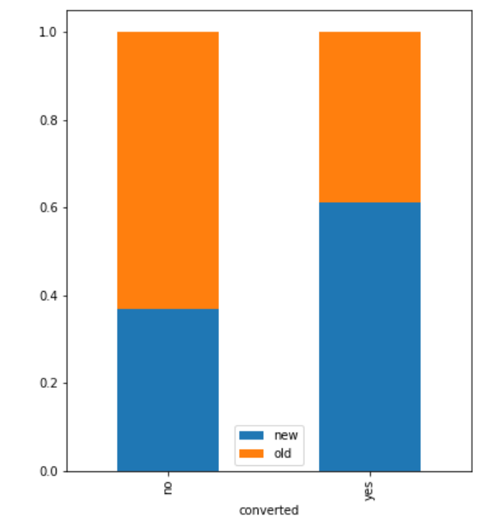
Hypotheses Tested and Results
Is the conversion rate (the proportion of users who visit the landing page and get converted) for the new page greater than the conversion rate for the old page?
Visually comparing the conversion rate for the new page and the conversion rate for the old page.
Hypothesis Tested: Test to compare two sample proportions from two populations-2 Sample Proportion Z test
The numbers of users served the new and old pages are 50 and 50 respectively.
The p-value is 0.008026308204056278 and is less than level of significance (α).
Inference
Therefore, I have enough statistical evidence to reject the null hypothesis and support the claim that conversion rate for the new page is greater than conversion rate for the old page.

Slide 18
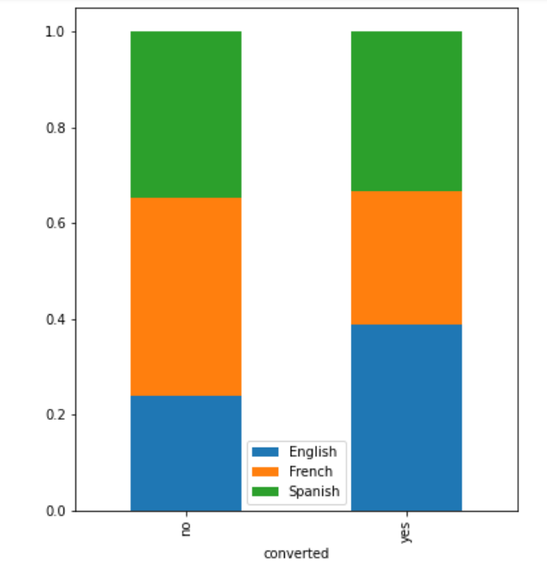
Hypotheses Tested and Results
Does the converted status depend on the preferred language?
View of the plot which shows the dependency between conversion status and preferred language.
Visually it seems that about 40% of users who speak French did not convert (no category), while 40% of users who speak English converted (yes category).
Hypothesis Tested: Test to check dependence relationship between two categorical variables - Chi-square Test for Independence
The p-value is 0.21298887487543447
Inference:
Since p-value is greater than the level of significance (α), I fail to reject the null hypothesis because I don’t have enough statistical evidence to say that converted status is dependent on the preferred language.

Slide 19
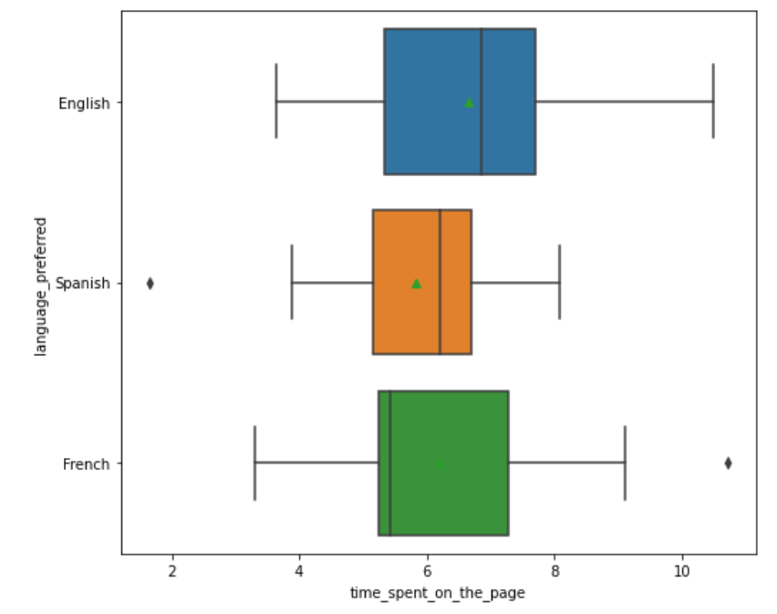
Hypotheses Tested and Results
Is the time spent on the new page same for the different language users?
View of the plot which shows time spent on the new page by different language users.
Hypothesis tested- Test to compare sample means from more than two independent populations-One way Anova Test
The p-value is 0.43204138694325955
Inference
P-value is greater than our level of significance (α), I fail to reject the null hypothesis because I do not have enough statistical evidence to conclude otherwise, therefore we accept that the mean time spent on the new landing page is the same for all three preferred language users.

Slide 20
APPENDIX

Slide 21
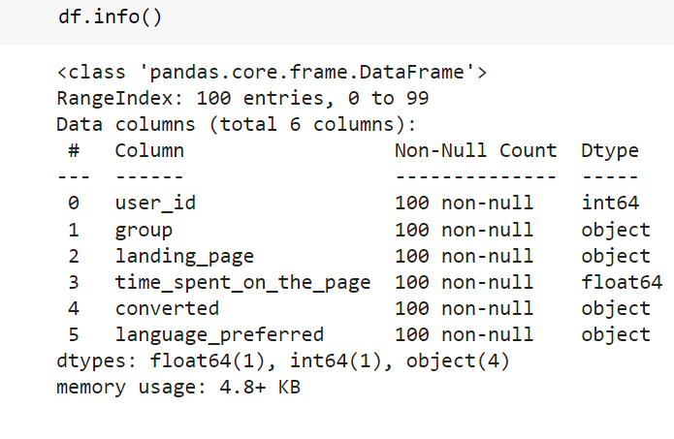
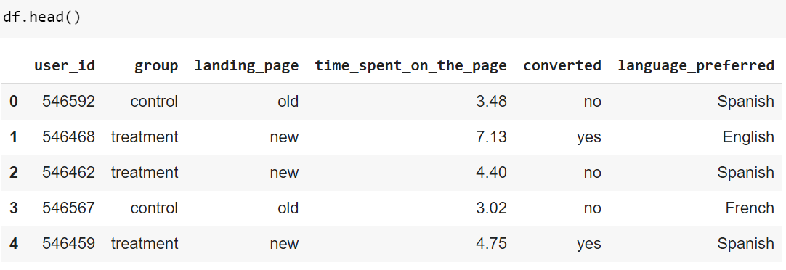
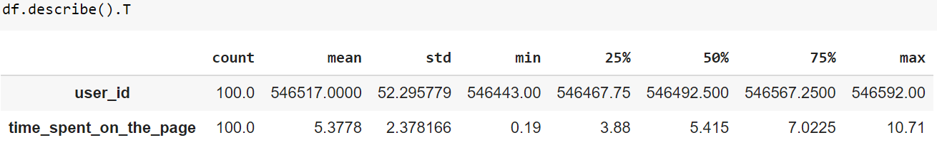
Data Background and Contents
Numerical Statistical Summary

Slide 22
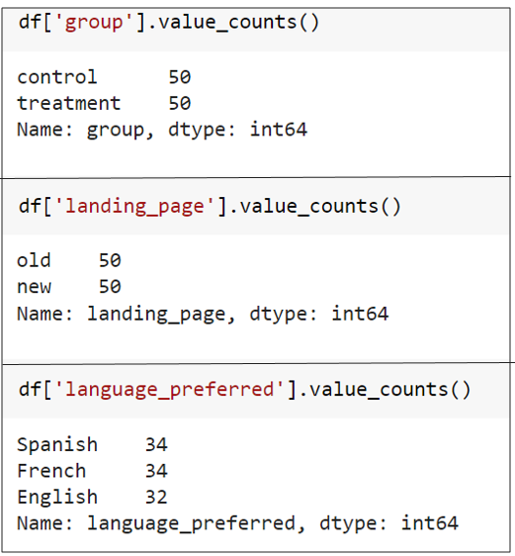
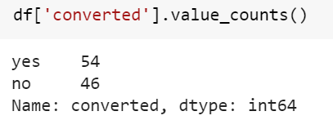
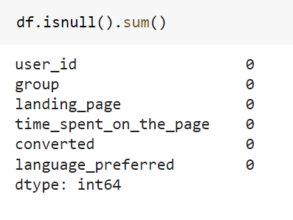
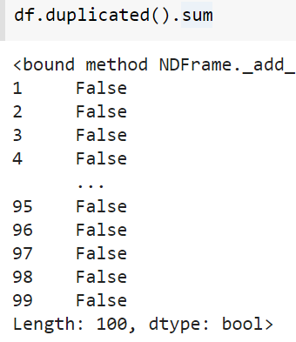
Data Background and Contents
To find duplicated values
To find missing values

Slide 23
Hypothesis Testing Details
Do the users spend more time on the new landing page than the existing landing page?
Hypothesis Test: 2 Sample Independent t-test
Null and Alternative Hypotheses:
𝝁1:average time spent on new landing page
𝝁2: average time spent on old landing page
H0 : 𝝁1 = 𝝁2
Ha : 𝝁1 > 𝝁2
p-value obtained: 0.0001392381225166549
The sample standard deviation of the time spent on the new page is: 1.82 ,The sample standard deviation of the time spent on the new page is: 2.58

Slide 24
Hypothesis Testing Details
Is the conversion rate (the proportion of users who visit the landing page and get converted) for the new page greater than the conversion rate for the old page?
Hypothesis Test: 2 Sample Proportion Z test
Null and Alternative Hypotheses:
p1: proportion of users who visit the landing page and get converted (conversion rate) for new page
p2: proportion of users who visit the landing page and get converted (conversion rate) for old page
H0 : p1 = p2
Ha : 𝝁1 > 𝝁2
p-value obtained: 0.008026308204056278
The numbers of users served the new and old pages are 50 and 50 respectively

Slide 25
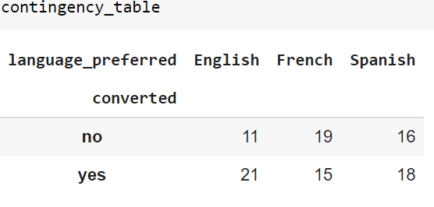
Hypothesis Testing Details
Does the converted status depend on the preferred language?
Hypothesis Test: Chi Square Test of independence
Null and Alternative Hypotheses:
H0: Converted status is independent of the preferred language
Ha: Converted status is dependent of the preferred language
p-value obtained: 0.21298887487543447

Slide 26
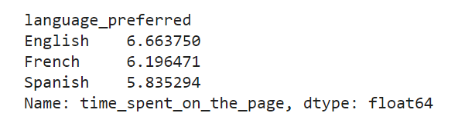
Hypothesis Testing Details
Does the converted status depend on the preferred language?
Hypothesis Test: One way Anova Test
Null and Alternative Hypotheses:
Let μ be the mean time spent on the new landing page
H0: The mean time spent on the new landing page is the same for all three preferred language users.
Ha: At least one of the mean time spent on the new landing page differs from the other two preferred language users.
p-value obtained: 0.43204138694325955

Slide 27
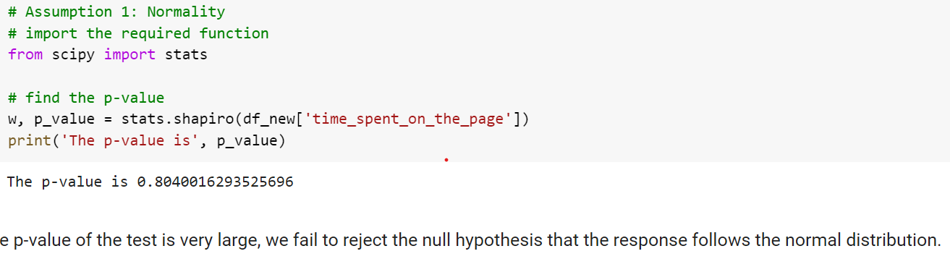
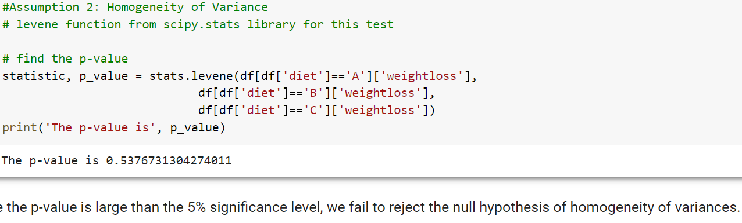
Hypothesis Testing Details
I carried out Shapiro Wilk and Levene tests to be absolutely sure that our distribution was normal and variance was homogenous.

